Slide 1




SALES FORECASTING AND OPTIMIZATION PROJECT

Slide 2

OUR TEAM
Amira Tantawy
Hussam Eldin Ahmed
Mohammed Samy
Salma Ahmed
Seif Eldin Ahmed
Youmna Mohammed

Slide 3
ABSTRACT
This project presents a comprehensive approach to sales forecasting for a supermarket using data science and machine learning. Historical transactional data was analyzed to uncover trends, optimize inventory, and improve decision-making. The final deliverables included an accurate predictive model (XGBoost), interactive visualizations, and a web-based deployment system. The project demonstrates how data-driven strategies can enhance operational efficiency and customer satisfaction in retail environments.

Slide 4
INTRODUCTION
Accurate sales forecasting is essential for retail businesses. It facilitates efficient inventory management, reliable demand prediction, and improved customer satisfaction. This project was conducted to develop a robust forecasting model using historical sales data from a supermarket. The initiative spanned data preprocessing, analysis, model development, and deployment, with a focus on deriving actionable business insights and boosting profitability.

Slide 5
PROJECT GOALS
1.
Goals
Develop an accurate sales forecasting model.
Discover insights from historical sales data.
Enhance inventory optimization and customer service.
2.
Objectives
Analyze historical data to identify key trends.
Build predictive models for sales forecasting.
Create an interactive dashboard for real-time monitoring.
Improve business decisions through analytics.
Optimize inventory and promotions for better
customer satisfaction.

Slide 6
PROJECT SCOPE
Collect and preprocess transactional sales data.
Conduct exploratory data analysis (EDA).
Engineer features for forecasting.
Train and optimize machine learning models.
Deploy the forecasting system via a web app (Flask).
Create dashboards and visualizations for stakeholder use.
Tools: Python, XGBoost, Flask, Plotly, Pandas

Slide 7
METHODOLOGY
1. Data Collection & Preprocessing:
Kaggle dataset
Cleaned missing values, encoded categoricals, scaled numerics
2. EDA:
Visualized trends by branch, product, and payment method
3. Modeling:
Compared Linear Regression, Decision Tree, Random Forest, XGBoost
XGBoost selected (lowest RMSE)
4. Deployment:
Flask API with front-end form for inputs and forecasts

Slide 8
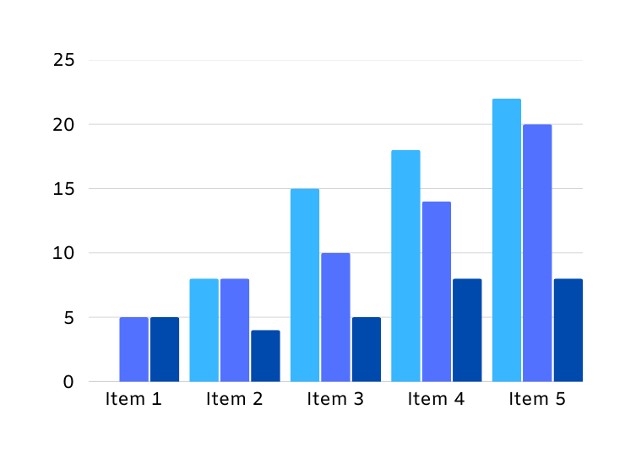
KEY INSIGHTS
Key Insights
Top Revenue Source: Food & Beverages
Popular Payment Method: Ewallet
Sales Trend: End-of-month spikes
Effective Features: Quantity, Unit Price, Tax

Slide 9
MODEL DEMONSTRATION

Slide 10
Use CASES
Short-Term Forecasting: Daily/weekly stock planning
Branch-Level Planning: Customize strategy per location
Marketing Alignment: Run promotions based on predicted spikes

Slide 11
FUTURe ImprovEMENTS
Model Enhancements: Add seasonal and holiday effects
Live Data Integration: Connect to supermarket POS systems
Retraining Pipeline: Auto-refresh model with new data
Mobile-Friendly Dashboard: For on-the-go managers

Slide 12
MODEL DEPLOYMENT
Saved the model for any future use.
Tested the API with Postman Application and had the appropriate predicted result output.

Slide 13
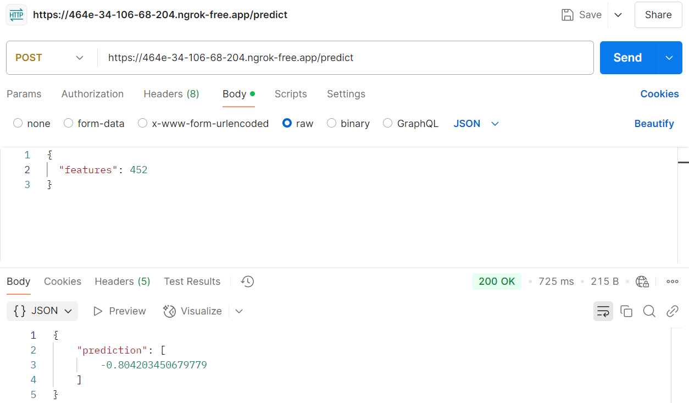
MODEL DEPLOYMENT

Slide 14
Q&A
Session

Slide 15
THANK
YOU

